Slide 1
15 Cancer Symptoms Women Should NOT Ignore
http://www.slideworld.org/slideshow.aspx/15-Cancer-Symptoms-ppt-2843657

Slide 2
Women are generally more vigilant than men on health care matters

Slide 3
But
Exceptions are always there …

Slide 4
There are some signs of cancer that women generally, carelessly ignore …

Slide 5
No. 1: Unexplained Weight Loss
Delighted to see yourself losing weight without actually trying to?
Beware!
Expect your doctor to run tests to check the thyroid and perhaps order a CT scan of different organs.

Slide 6
No. 2: Bloating
Bloating is so common that many women just live with it. But it could point to ovarian cancer.
Notice symptoms like
abdominal pain
pelvic pain,
feeling full quickly -- even when you haven't eaten much
and urinary problems, such as having an urgent need to go to the bathroom.

Slide 7
No. 3: Breast Changes
Redness and thickening of the skin on the breast, which could indicate inflammatory breast cancer
Change in the look of a nipple,
unusual discharge
are generally ignored.

Slide 8
No. 4: Between-Period Bleeding or Other Unusual Bleeding
Premenopausal women tend to ignore between-period bleeding
Also bleeding from the GI tract
So does bleeding after menopause,
These are symptoms of
endometrial cancer
colorectal cancer

Slide 9
No. 5: Skin Changes
Most of us know to look for any changes in moles -- a well-known sign of skin cancer. But we should also watch for changes in skin pigmentation
Sudden scaling of the skin or bleeding are some other symptoms of skin cancer.

Slide 10
No. 6: Difficulty Swallowing
Experiencing difficulty in swallowing? Switched to shakes and soups, haven’t you?
But this is a very prominent sign of GI cancer, such as in the esophagus

Slide 11
No. 7: Blood in the Wrong Place
If you notice blood in your urine or your stool, don’t assume it's from a hemorrhoid. It could be colon cancer.
Coughing up blood should be evaluated, too

Slide 12
No. 8: Gnawing Abdominal Pain and Depression
Got a pain in the abdomen?
feeling depressed?
You need a check up right away.
Researches prove that there is a link between depression and pancreatic cancer

Slide 13
No. 9: Indigestion
Indigestion during pregnancy or while gaining weight is normal. But indigestion for no apparent reason may be a red flag.
It could be an early clue to cancer of the esophagus, stomach, or throat.

Slide 14
No. 10: Mouth Changes
Smokers should be especially alert for any white patches inside the mouth or white spots on the tongue.
Both can point to a precancerous condition called leukoplakia that can progress to oral cancer.

Slide 15
No. 11: Pain
Pain that persists and is unexplained needs to be checked out.
They can be an early symptom of some cancers

Slide 16
No. 12: Changes in the Lymph Nodes
If you notice a lump or swelling in the lymph nodes under your armpit or in your neck -- or anywhere else -- it could be worrisome

Slide 17
No. 13: Fever
If you have a fever that isn't explained by influenza or other infection, it could point to cancer. O Yes! That’s True/
Fevers more often occur after cancer has spread from its original site, but it can also point to early blood cancers such as leukemia or lymphoma,
Other cancer symptoms can include jaundice, or a change in the color of your stool.

Slide 18
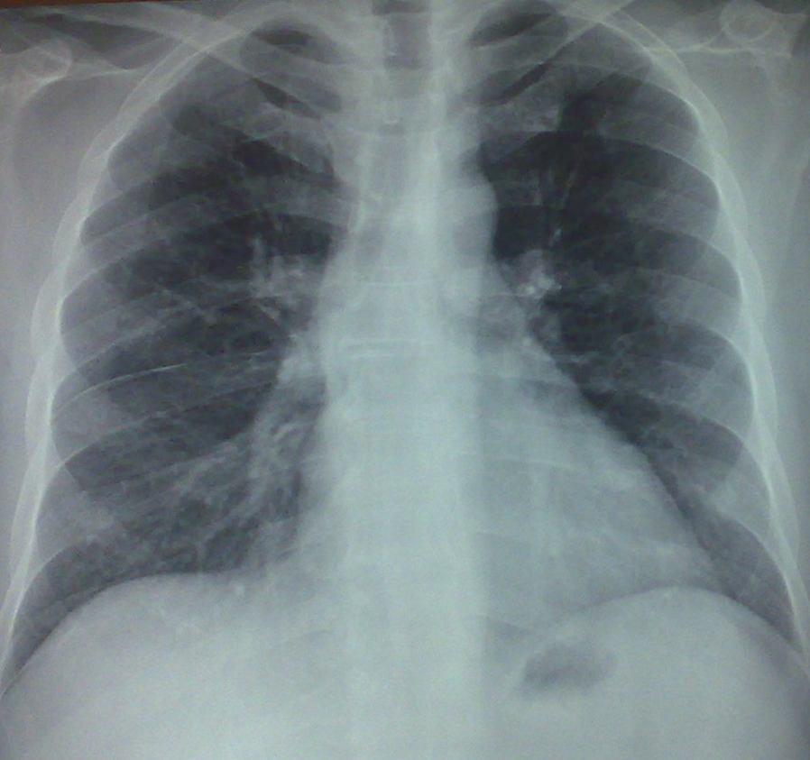
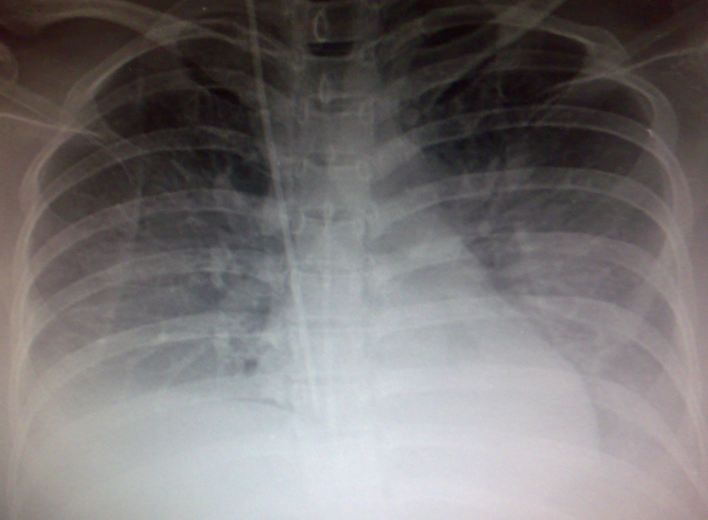
No. 14: Fatigue
Fatigue is another vague symptom that could point to cancer

Slide 19
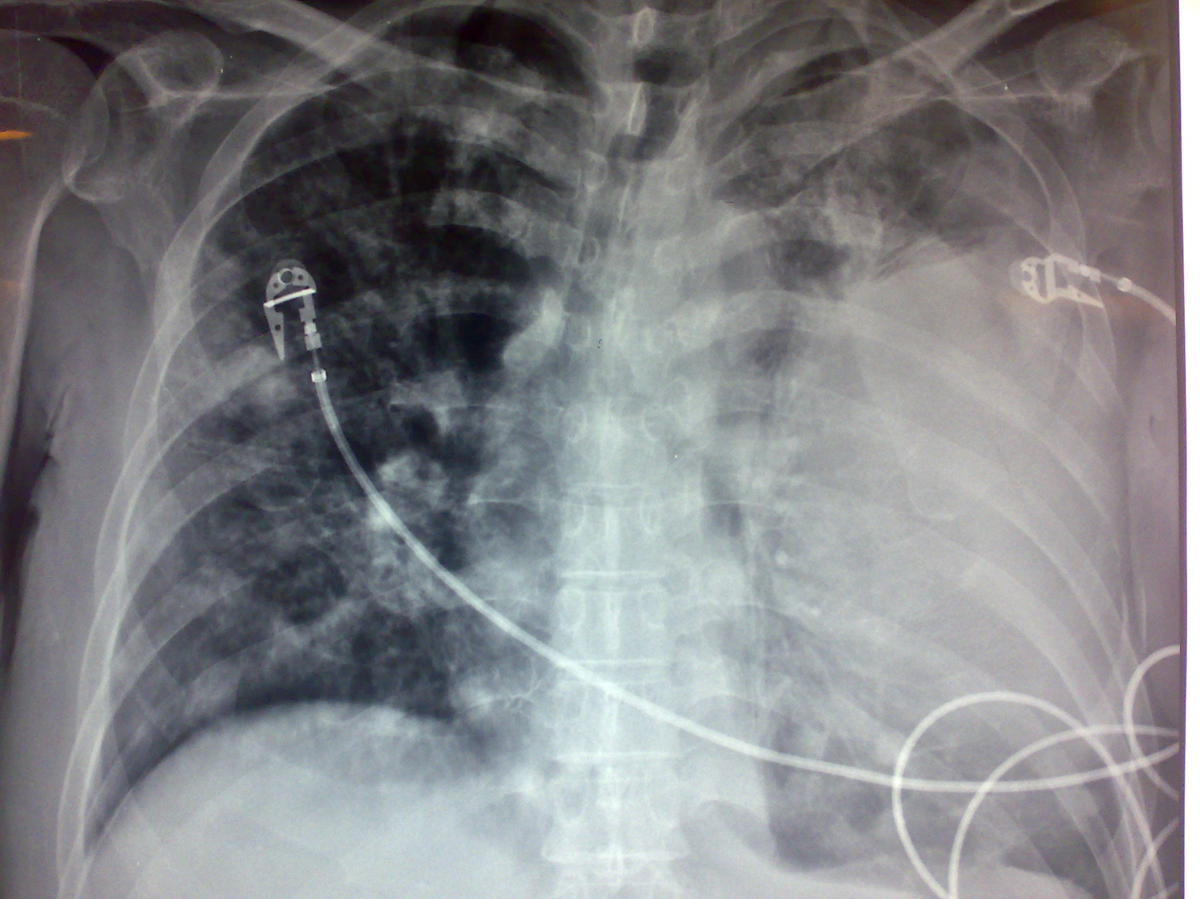
No. 15: Persistent Cough
a very prolonged cough -- defined as lasting more than three or four weeks – can mean cancer.

