Slide 1
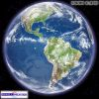
CLIMATE CHANGE UPDATE
Echo from Talk of
Environmentalist NICANOR PERLAS
Mid-Year PCCP
Cagayan de Oro 26 July, 2013

Slide 2
Where The Pale Blue Dot Is …
Some 3,000,000 years go,, from natural cause, the earth had a C02 440 ppm in its environment
Last May 9,2013 the world surpassed that threshold … from man-made causes

Slide 3
Significance of C02 in atmosphere
Arctic Ice did not exist
Sea level is 40m above current level
Major coastal areas were under water.

Slide 4
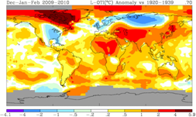
The GaseWarming the Globe
Carbon dioxide
Methane -20x more powerful in heating air
Nitrous oxide – 200 x more powerful in heating the air
Taken together: carbon concen
478ppm CO – crossing point of no return
  450ppm - supposed to be coming 2050
    37 years early

Slide 5
2012 -78% arctic ice is gone.
In 7 years, it is expected to have no ice
  …. Expect
    Methane gas to accelerate climate change
    About Greenland
      Supposed to melt a few centuries later
        Expect 200meters RISE in sea level
        Meantime see superstorms
          Like sendong ondoy, etc

Slide 6
Superstorms will be the norm …
  Expect increase in number
  Fr interview PAGASA ..
    2 superstorms within the year
    Superstorms shifting to the Visayas and Mindanao
22 typhoons / year
  PHILIPPINES – ranks second worldwide in terms of # typhoons/year
    2009 – we had 5 superstorms

Slide 7
Sendong disaster – predicted 6 months before in happened
  NASA study

Slide 8
320 watersheds in the Philippines / accd to the Filipino scientist in NASA
  PREDICTED the Sendong 6months BEFORE
  When it happened , he predicted PABLO
GLOBAL WARMING IS GETTING OUT OF CONTROL
PAGASA are predicting in 50 years data, will see polarity
  Extreme wetness and dry
    Increase ozone

Slide 9
Problems with pulmonary problem will escalate
More costal areas disappearing
Panglao beach cost is losing coast
50m inland in tacloban beach diasppearing
Climate change …
  Talks in DOHA in climate change collapsed – no uniform decision

Slide 10
Coal plants is a disaster as far as climate change is concerned.

Slide 11
Philippines
One of the global center for drastic climate change
Within the top 3 among the hot spots for climate change

Slide 13
LOCAL HIV UPDATE

Slide 14
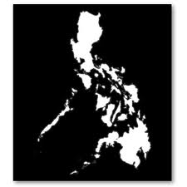
Newly Diagnosed HIV Cases in the Philippines
In May 2013, there are 415 new HIV Ab seropositive individuals confirmed by STD/AIDS Cooperative Central Lab (SACCL)
  52% higher compared to the same period in 2012 (n=273)
  Highest number of cases reported in a month
Update: June 2013
= 436
National Epidemiology Center, DOH
Philippine HIV and AIDS registry, May 2013

Slide 15
Number of new HIV cases in May 2013, highest monthly rate since 1984 — DOH
May 2012: 273 May 2013: 415
52% higher
13,594 cases since 1984
99% were 15-24 years old
398 or 96% were men
7 or 4% were women
409 cases: sexual contact 6 cases: IV drug users
8 out 10 were caused by MSM

Slide 16
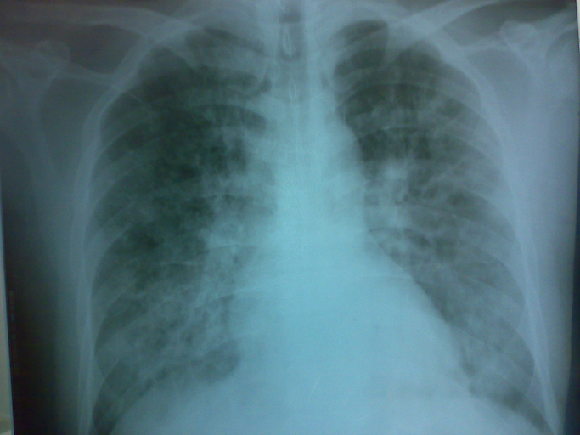
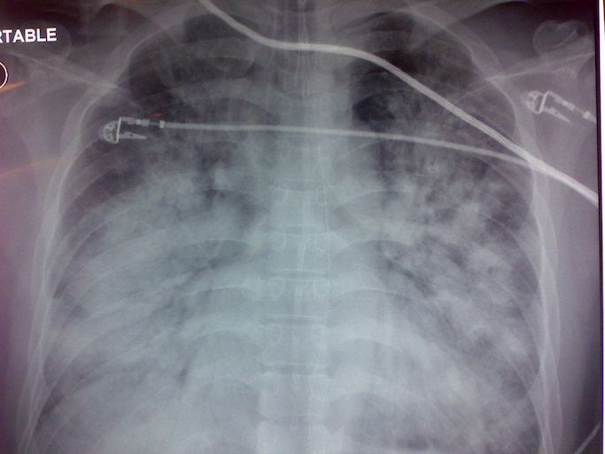
HIV and Pulmonary Infections
Up to 70% of HIV patients have a pulmonary complication mainly of infectious etiology.
Pulmonary infection remains a significant contributor to the morbidity and mortality of HIV.
Clear association between immunosuppression and the risk of developing specific pulmonary infections ²
Benfield TL et al, HIV-1, cytokines, and the lung. Cytokines in pulmonary disease: infection and inflammation.
New York: Marcel Dekker; 2000. p. 331–364.
² Hanson DL, et al . Distribution of CD4+ T lymphocytes at diagnosis of AIDS and other HIV-elated illnesses.
Arch Intern Med 1995;155:1537-42

Slide 17



